Slide 1
Lecture 3 Dynamic Programming

Slide 2
Algorithmic Paradigms
Greedy: Build up a solution incrementally, myopically optimizing some local criterion.
Divide-and-conquer: Break up a problem into independent subproblems, solve each subproblem, and combine solution to subproblems to form solution to original problem.
Dynamic programming: Break up a problem into a series of overlapping subproblems, and build up solutions to larger and larger subproblems.

Slide 3
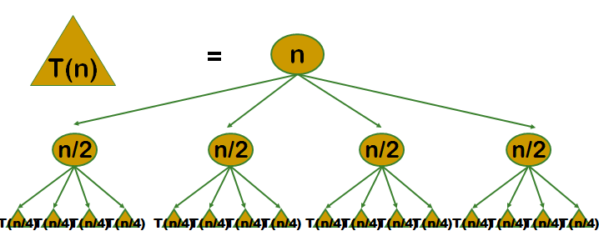
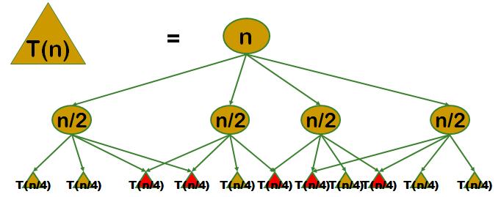
DC v.s. DP

Slide 4
Definition
Dynamic Programming (DP) is a method for solving complex problems by breaking them down into simpler subproblems. It is applicable to problems exhibiting the properties of overlapping subproblems and optimal substructure.
A problem is said to have overlapping subproblems if the problem can be broken down into subproblems which are reused several times or a recursive algorithm for the problem solves the same subproblem over and over rather than always generating new subproblems.
A problem is said to have optimal substructure if an optimal solution can be constructed efficiently from optimal solutions of its subproblems.

Slide 5
Dynamic Programming
History
Richard Bellman pioneered the systematic study of dynamic programming in 1950s.
Applications
Bioinformatics.
Control theory.
Information theory.
Operations research.
Computer science: theory, graphics, AI, compilers, systems…

Slide 6
Dynamic Programming Approaches
Top-down approach: This is the direct fall-out of the recursive formulation of any problem. If the solution to any problem can be formulated recursively using the solution to its subproblems, and if its subproblems are overlapping, then one can easily memoize or store the solutions to the subproblems in a table. Whenever we attempt to solve a new subproblem, we first check the table to see if it is already solved. If a solution has been recorded, we can use it directly, otherwise we solve the subproblem and add its solution to the table.
Bottom-up approach: Once we formulate the solution to a problem recursively as in terms of its subproblems, we can try reformulating the problem in a bottom-up fashion: try solving the subproblems first and use their solutions to build-on and arrive at solutions to bigger subproblems.

Slide 7
Development of DP algorithms
Characterize the structure of an optimal solution.
Define subproblems (states).
Write down the recurrence that relates subproblems.
Compute the value of an optimal solution.
Construct an optimal solution from computed information.

Slide 8
Fibonacci and Jump Steps Problem
Naive Recursive Function:
Top-down Approach:
Bottom-up Approach
int Fib(int n) {
if (n==1 || n==2) return 1;
return Fib(n-1)+Fib(n-2);
}
int Fib(int n) {
if (n==1 || n==2) return 1;
if (F[n] is defined) return F[n];
F[n] = Fib(n-1)+Fib(n-2);
return F[n];
}
F[1] = F[2] = 1;
for (int i = 3; i < N; i++) F[i] = F[i-1]+F[i-2];
Notes:
O(F(n)) -> O(n)

Slide 9
Fibonacci and Jump Steps Problem
Problem: A frog can jump up 1, 3, or 4 steps in each move, calculate the number of different ways for the frog to achieve the n-th steps.
Example:
for n = 5, the answer is 6,
5 = 1+1+1+1+1
= 1+1+3
= 1+3+1
= 3+1+1
= 1+4
= 4+1

Slide 10
Fibonacci and Jump Steps Problem
Let D_{n} be the number of ways to write n as the sum of 1, 3, 4.
Find the recurrence
D_{n} = D_{n-1} + D_{n-3} + D_{n-4}
Solve the base cases
D₀ = 1
D_{n} = 0 for all negative n
Implementation
D[0] = 0;
D[1] = D[2] = 1;
D[3] = 2;
for (int i = 4; i<= n; i++)
D[i] = D[i-1] + D[i-3] + D[i-4];

Slide 11
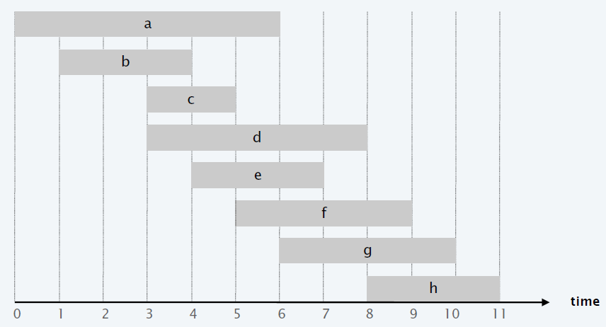
Weighted interval scheduling
Job j starts at s_{j}, finishes at f_{j}, and has weight or value v_{j}.
Two jobs compatible if they don't overlap.
Goal: find maximum weight subset of mutually compatible jobs.

Slide 12
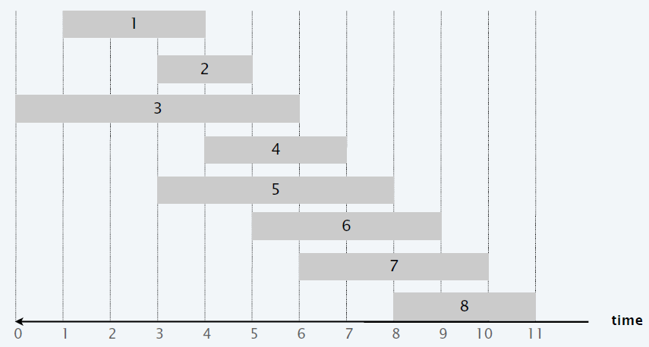
Weighted interval scheduling
Consider jobs in ascending order of finish time: f₁ ≤ f₂ ≤ . . . ≤ f_{n} .
Greedy algorithm is correct if all weights are 1.
Greedy algorithm fails for weighted version.
Let p (j) = largest index i < j such that job i is compatible with j.
Example:
p(8)=5,
p(7)=3,
p(2)=0.

Slide 13

Weighted interval scheduling
Let OPT(j) = value of optimal solution to the problem consisting of job requests 1, 2, ..., j.
Case 1. OPT selects job j.
Collect profit v_{j}.
Can't use incompatible jobs { p(j) + 1, p(j) + 2, ..., j – 1 }.
Must include optimal solution to problem consisting of remaining compatible jobs 1, 2, ..., p(j).
Case 2. OPT does not select job j.
Must include optimal solution to problem consisting of remaining compatible jobs 1, 2, ..., j – 1.

Slide 14
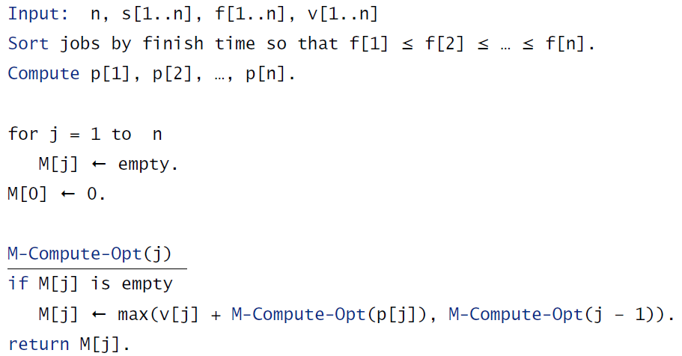
Weighted interval scheduling
Memoization: Cache results of each subproblem; lookup as needed.

Slide 15
Weighted interval scheduling
Memoized version of algorithm takes O(n log n) time.
Sort by finish time: O(n log n).
Computing p(⋅) : O(n log n) via binary search.
Overall running time of M-COMPUTE-OPT(n) is O(n).
Question. DP algorithm computes optimal value. How to find solution itself?
Answer: Traceback.

Slide 16
Longest Common Subsequence
The longest common subsequence (LCS) problem is to find the longest subsequence common to all sequences in a set of sequences.
Given two strings x and y, find the LCS and print its length.
Example:
x: ABCBDAB
y: BDCABC
"BCAB" is the longest subsequence found in both sequences, so the answer is 4.

Slide 17
Longest Common Subsequence
There are 2^{m} subsequences of X.
Testing a subsequence (length k) takes time O(k).
So brute force algorithm is O(n*2^{m}).
Divide-and-conquer or Greedy algorithm?

Slide 18
Longest Common Subsequence
Let two sequences be defined as follows: X = (x₁, x₂...x_{m}) and Y = (y₁, y₂...y_{n}). The prefixes of X are X_{1, 2,...m}; the prefixes of Y are Y_{1, 2,...n}.
Let LCS(X_{i},Y_{j}) represent the set of longest common subsequence of prefixes X_{i} and Y_{j}.
Find the recurrence
If x_{i} = y_{j} , they both contribute to the LCS. Then,
LCS(X_{i},Y_{j}) = LCS(X_{i-1},Y_{j-1}) + 1
Either x_{i} or y_{j} does not contribute to the LCS, so one can be dropped.
LCS(X_{i},Y_{j}) = max{ LCS(X_{i-1},Y_{j}), LCS(X_{i},Y_{j-1}) }
Find and solve the base cases:
LCS(X_{i},Y₀) = LCS(X₀,Y_{j}) = 0

Slide 19
Longest Common Subsequence
Implementation: O(nm)
for (i=0;i<=n;i++) LCS[i][0]=0;
for (j=0;j<=m;j++) LCS[0][j]=0;
for (i=1;i<=n;i++) {
for (j=1;j<=m;j++) {
if (x[i]==y[j]) LCS[i][j]=LCS[i-1][j-1]+1;
else LCS[i][j]=max(LCS[i-1][j],LCS[i][j-1]);
}
}

Slide 20
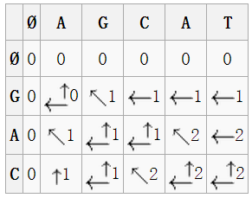
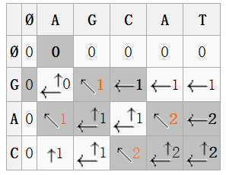
Longest Common Subsequence
Example:
X=(AGCAT)
Y=(GAC)
LCS matrix: Traceback example:

Slide 21
Longest Non-Decreasing Subsequence
The longest non-decreasing subsequence (LNDS) problem is to find a subsequence of a given sequence in which the subsequence's elements are in sorted order, lowest to highest, and in which the subsequence is as long as possible. This subsequence is not necessarily contiguous, or unique.
Example: Consider the following sequence
[1, 2, 5, 2, 8, 6, 3, 6, 9, 7]
[1, 5, 8, 9] forms a non decreasing subsequence, so does
[1, 2, 2, 6, 6, 7] but it is longer.

Slide 22
Longest Non-Decreasing Subsequence
Solve subproblem on s₁,...,s_{n-1} and then try to extend using s_{n}.
Two cases:
s_{n} is not used, answer is the same answer as on s₁,...,s_{n-1}.
s_{n} is used, answer is s_{n} preceded by the longest increasing subsequence in s₁,...,s_{n-1} that ends in a number smaller than s_{n}.
Recurrence:
Let L[i] be the length of longest non-decreasing subsequence in s₁,...,s_{n} that ends in s_{i}.
L[j]=1+max{L[i]: i<j and s_{i}<s_{j}}
L[0]=0
Length of longest increasing subsequence:
max{L[i]: 1≤ i ≤ n}

Slide 23
Longest Non-Decreasing Subsequence
We also maintain P[j] to be the value of i that achieved the max L[j].
This will be the index of the predecessor of s_{j} in a longest increasing subsequence that ends in s_{j}.
By following the P[j] values we can reconstruct the whole sequence in linear time.
Implementation: O(n²)
for (j = 1; j <= n; j++) {
L[j] = 1;
P[j] = 0;
for (i = 1; i < j; i++)
if (s[i]<s[j] && L[i]+1>L[j]) {
P[j] = i;
L[j] = L[i]+1;
}
}

Slide 24
Longest Non-Decreasing Subsequence
Exercise
index | 1 | 2 | 3 | 4 | 5 | 6 | 7 | 8 | 9 | 10
sequence | 1 | 2 | 5 | 2 | 8 | 6 | 3 | 6 | 9 | 7
L[i]
P[i]
index | 1 | 2 | 3 | 4 | 5 | 6 | 7 | 8 | 9 | 10
sequence | 1 | 2 | 5 | 2 | 8 | 6 | 3 | 6 | 9 | 7
L[i] | 1 | 2 | 3 | 3 | 4 | 4 | 4 | 5 | 6 | 6
P[i] | 0 | 1 | 2 | 2 | 3 | 3 | 4 | 6 | 8 | 8

Slide 25
Longest Non-Decreasing Subsequence
Improvement
Maintain the min.element array, which is a sorted array
Use binary search to update the table
O(n logn)
s[i] | index set | element set | min. element
0 | ∅ | ∅ | -
1 | {1} | {1} | 1
2 | {2} | {2} | 2
3 | {3,4} | {2,5} | 2
4 | {5,6,7} | {3,6,8} | 3
5 | {8} | {6} | 6
6 | {9,10} | {7,9} | 7
Non-decreasing
Order

Slide 26
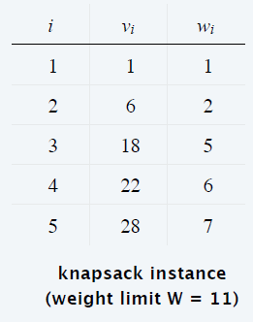
0-1 Knapsack Problem
Given n objects and a "knapsack.“
Item i weighs w_{i} > 0 and has value v_{i} > 0.
Knapsack has a capacity of W.
Goal: fill knapsack so as to maximize total value.
Example:
{ 1, 2, 5 } has value 35.
{ 3, 4 } has value 40.
{ 3, 5 } has value 46,
(but exceeds weight limit).

Slide 27
0-1 Knapsack Problem
Let OPT(i) = max profit subset of items 1, …, i.
Case 1. OPT does not select item i.
OPT selects best of { 1, 2, …, i – 1 }.
Case 2. OPT selects item i.
Selecting item i does not immediately imply that we will have to reject other items.
Without knowing what other items were selected before i, we don't even know if we have enough room for i.
Conclusion: Need more subproblems!

Slide 28
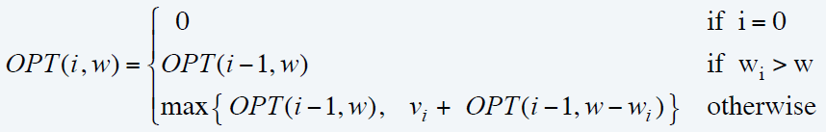
0-1 Knapsack Problem
Let OPT(i, w) = max profit subset of items 1, …, i with weight limit w.
Case 1. OPT does not select item i.
OPT selects best of { 1, 2, …, i – 1 } using weight limit w.
Case 2. OPT selects item i.
New weight limit = w – w_{i}.
OPT selects best of { 1, 2, …, i – 1 } using this new weight limit.

Slide 29
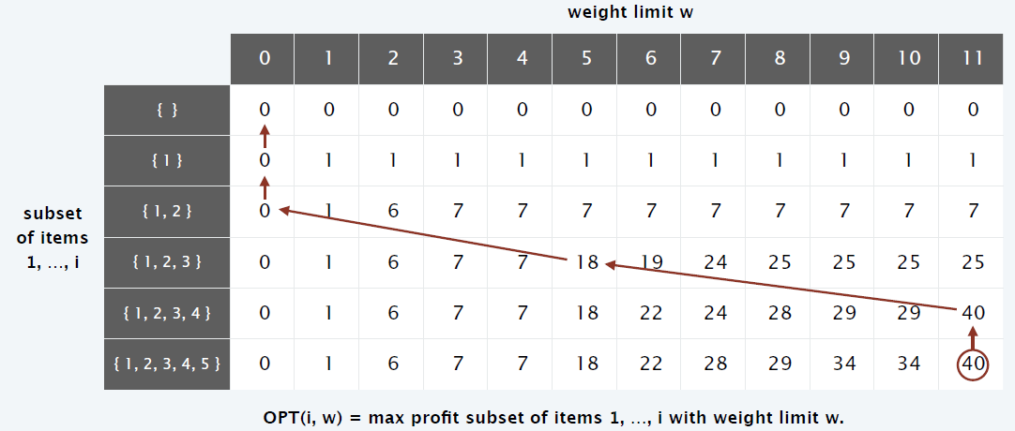
0-1 Knapsack Problem
Implementation: O(nW)
for (w = 0; w <= W; w++)
M[0, w] = 0;
for (i = 1; i <= n; i++)
for (w = 1; w <= W; w++)
if (wt[i] > w) M[i, w] = M[i – 1, w];
else M[i, w] = max { M[i – 1, w], v[i] + M[i – 1, w – wt[i]] };
return M[n, W];

Slide 30
Matrix-Chain Multiplication
Let A be an n by m matrix, let B be an m by p matrix, then C = AB is an n by p matrix.
C = AB can be computed in O(nmp) time, using traditional matrix multiplication.
Suppose we want to compute A₁A₂A₃A₄.
Matrix Multiplication is associative, so we can do the multiplication in several different orders.
Given n matrices, the size of the matrix A_{i} is p_{i-1}*p_{i}, find the minimum multiplication operations.

Slide 31
Matrix-Chain Multiplication
Example:
A₁ is 10 by 100 matrix
A₂ is 100 by 5 matrix
A₃ is 5 by 50 matrix
A₄ is 50 by 1 matrix
A₁A₂A3A4 is a 10 by 1 matrix
5 different orderings = 5 different parenthesizations
(A₁(A₂(A₃A₄)))
((A₁A₂)(A₃A₄))
(((A₁A₂)A₃)A₄)
((A₁(A₂A₃))A₄)
(A₁((A₂A₃)A₄))

Slide 32
Matrix-Chain Multiplication
(A₁(A₂ (A₃A₄)))
A₃₄ = A₃A₄ , 250 mults, result is 5 by 1
A₂₄ = A₂A₃₄ , 500 mults, result is 100 by 1
A₁₄ = A₁A₂₄ , 1000 mults, result is 10 by 1
Total is 1750
((A₁A₂)(A₃A₄))
A₁₂ = A₁A₂ , 5000 mults, result is 10 by 5
A₃₄ = A₃A₄ , 250 mults, result is 5 by 1
A₁₄ = A₁₂A₃₄ , 50 mults, result is 10 by 1
Total is 5300
(((A₁A₂)A₃)A₄)
A₁₂ = A₁A₂ , 5000 mults, result is 10 by 5
A₁₃ = A₁₂A₃ , 2500 mults, result is 10 by 50
A₁₄ = A₁₃A₄ , 500 mults, results is 10 by 1
Total is 8000

Slide 33
Matrix-Chain Multiplication
((A₁(A₂A₃))A₄)
A₂₃ = A₂A₃ , 25000 mults, result is 100 by 50
A₁₃ = A₁A₂₃ , 50000 mults, result is 10 by 50
A₁₄ = A₁₃A₄ , 500 mults, results is 10 by 1
Total is 75500
(A₁ ((A₂A₃)A₄))
A₂₃ = A₂A₃ , 25000 mults, result is 100 by 50
A₂₄ = A₂₃A₄ , 5000 mults, result is 100 by 1
A₁₄ = A₁A₂₄ , 1000 mults, result is 10 by 1
Total is 31000
Conclusion: Order of operations makes a huge difference. How do we compute the minimum?

Slide 34
Matrix-Chain Multiplication
Parenthesization: A product of matrices is fully parenthesized if it is either
a single matrix, or
a product of two fully parenthesized matrices, surrounded by parentheses
Each parenthesization defines a set of n-1 matrix multiplications. We just need to pick the parenthesization that corresponds to the best ordering.
Question: How many parenthesizations are there?

Slide 35
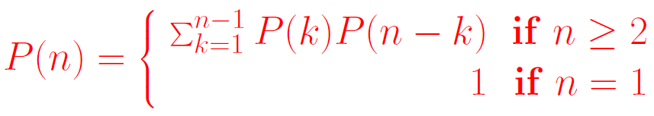


Matrix-Chain Multiplication
.
Let P(n) be the number of ways to parenthesize n matrices.
This recurrence is related to the Catalan numbers
Asymptotically, the Catalan numbers grow as

Slide 36
Matrix-Chain Multiplication
Structure of an optimal solution: If the outermost parenthesization is
((A₁A₂ · · ·A_{i})(A_{i+1} · · ·A_{n}))
then the optimal solution consists of solving A_{1,i} and A_{i+1,n} optimally and then combining the solutions.
Overlapping subproblems: In the enumeration of the P(n) = Ω(4^{n}/n^{3/2}) subproblems, how many unique subproblems are there?

Slide 37

Recursive solution
A subproblem is of the form A_{ij} with 1<=i<=j<=n, so there are O(n²) subproblems.
Let A_{i} be p_{i−1} by p_{i} .
Let m[i, j] be the cost of computing A_{ij}
If the final multiplication for A_{ij} is A_{ij} = A_{ik}A_{k+1,j} then
m[i, j] = m[i, k] + m[k + 1, j] + p_{i−1}p_{k}p_{j} .
We don’t know k a priori, so we take the minimum
Direct recursion on this does not work! We must use the fact that there are at most O(n²) different calls. What is the order?

Slide 38
Homework
Sicily:
1121，简单，DP[i][j] 考虑前i列、缺口状态为第j种情况
1148 ，简单
1527 ，简单，参考1121
1342 , 背包DP
1345 ，中等， 以聚合的次数划分阶段进行DP

Slide 39
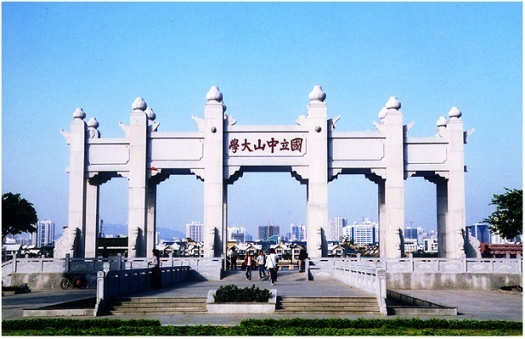
Thank you!

